Slide 1
Personality Prediction System
A fair cv ranking system
By
Aishwarya yerram
1602-14-737-065

Slide 2

Objective
This will enable a more effective way to short list submitted candidate CVs from a large number of applicants .
This system will help the HR department to easily shortlist the candidate .
The proposed system produces ranking decisions that were relatively highly consistent with those of the human experts.
The presented system automates the processes of requirements specification and applicant's ranking.

Slide 3
Overview
Candidate here will register him/herself with all its details and will upload their own CV into the system, which will be further used by the system to shortlist their CV.
Candidate can also give an online test, which will be conducted on personality questions as well as aptitude questions.
After completing the online test, candidate can view their own test results in graphical representation with marks.

Slide 4
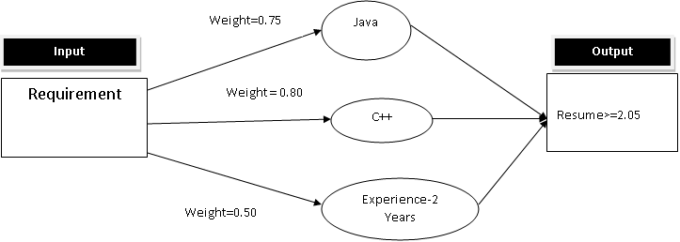
Overview
Neuro Fuzzy Logic Explanation
We use neural network
System will assign weight age for each requirement
Resume will be shortlisted based on overall weight age

Slide 5
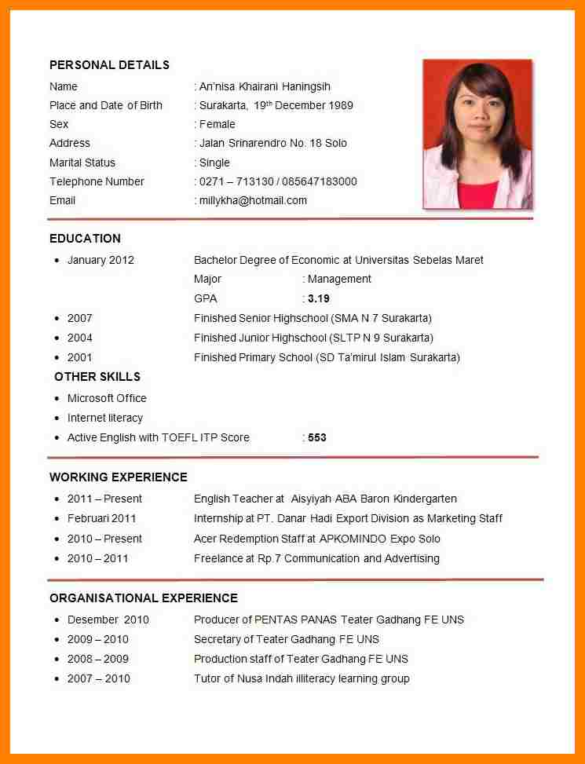
Evaluation will be done and results along with graph will be given
Certain feedbacks will be individually provided too.

Slide 6
Survey
There are a lot of candidates these days who apply for job and whom to shortlist is a big question and a very difficult task.
Need of one fine evaluation system is there and if manual considerations can be taken, these may result in biased decisions.
So, this system enables a more effective way to short list submitted candidate CVs from a large number of applicants providing a consistent and fair CV ranking policy, which can be legally justified.
System will rank the experience and key skills required for particular job position.

Slide 7
Advantages
This system can be used in many business sectors that may require expert candidate.
This system will reduce workload of the human resource department.
This system will help the human resource department to select right candidate for particular job profile, which in turn provide expert workforce for the organization.
Admin or the concern person can easily shortlist a candidate based on their online test marks and can select an appropriate candidate for desired job profile.

Slide 8
ANALYSIS
Modules:
Admin:
Login: Admin need to login with its valid credentials to access the below modules.
Add Personality Questions: Here, admin can add all the personality related questions.
Add Aptitude Questions: Admin can add aptitude questions of three subject as English, math’s and programming with its respective four options.
Add Job Details: Admin or any authorized person can add the requirement or job details on behalf of company.
Preferred CV’s: Admin will add some CV’s which are preferable and will be used to shortlist the scanned CV’s.
Scan CV: Admin can scan CV’s received from candidates which will undergo the process of shortlisting the CV’s.
Shortlisted CV’s: Here, all the shortlisted CV’s of candidates will be displayed. The shortlisting of CV’s is performed by system itself.
View Candidates: Can view all the registered candidates with its details.
View Result: Can view the results of individual candidate, which can be easy to admin or concern person to select a desired candidate.

Slide 9
ANALYSIS
Candidate:
Registration: To access the below given modules, candidate must fill up registration form and create login credentials in order to get the access to the system. While registration process, candidate need to upload their CV.
Login: Candidate need to enter valid credentials to access the below given modules.
Give Test: After successful login, candidate can now proceed with online test based on personality and aptitude.
View Results: Once the test is completed by the candidate, the results will be displayed in a graphical representation.

Slide 10
SPECIFICATIONS
SOFTWARE
HARDWARE
OS: Ubuntu -16.04
Ruby on Rails
Rails console
Bootstrap(styling)
Processor – i3
Hard Disk – 5 GB
Memory – 4GB RAM
Internet Connection

Slide 11
References
https://nevonprojects.in
http://ieeexplore.ieee.org/document/6118590/
http://ieeexplore.ieee.org/document/5566454/
http://ieeexplore.ieee.org/document/7473448/

Slide 12
THANK YOU

